Slide 1

DIVINE GRACE COLLEGE OF ARTS, SCIENCE AND TECHNOLOGY
(DGCAST) — GAROUA | GEOGRAPHY DEPARTMENT
UPPER SIXTH ARTS — ENVIRONMENT AND DEVELOPMENT — LESSON 7
Notion of Development
Mr KAMDEM EMMANUEL
Geography Teacher — PLEG
Academic Year 2026 / 2027
Notes:
Good morning, class. Today we study Lesson 7: Notion of Development.

Slide 2
GEOGRAPHY — UPPER SIXTH ARTS
CLASS INFO
Class, Chapter & Duration
Class | Upper Sixth Arts
Chapter | Module 7: Understanding and managing contemporary environmental and development issues
Duration | 2 periods (2 × 50 minutes)
2026 / 2027
DGCAST GAROUA — GEOGRAPHY DEPARTMENT
Mr KAMDEM E. | 2

Slide 3
GEOGRAPHY — UPPER SIXTH ARTS
IDENTIFICATION
Lesson Identification
Topic | Current Development Issues
Sub-topic | Concept of Development
Lesson | Lesson 7: Notion of Development
Notions / Concepts | Development, economic growth, GNI, HDI, development gap, sustainable development.
Syllabus focus | Meaning of development, economic development and growth; reasons for the gap between rich and poor; economic and social criteria (HDI); classification of countries; sustainable development and ways to achieve it.
Competence | Learners are able to measure development, explain the development gap and suggest ways to achieve sustainable development.
2026 / 2027
DGCAST GAROUA — GEOGRAPHY DEPARTMENT
Mr KAMDEM E. | 3

Slide 4
GEOGRAPHY — UPPER SIXTH ARTS
OBJECTIVES
Learning Objectives
By the end of the lesson, the learner should be able to:
Distinguish development and economic growth.
Measure development with economic and social criteria.
Explain the development gap and sustainable development.
2026 / 2027
DGCAST GAROUA — GEOGRAPHY DEPARTMENT
Mr KAMDEM E. | 4

Slide 5
GEOGRAPHY — UPPER SIXTH ARTS
RECALL
Recall
Some countries are rich and others poor.
Health and education improve people's lives.
2026 / 2027
DGCAST GAROUA — GEOGRAPHY DEPARTMENT
Mr KAMDEM E. | 5

Slide 6
GEOGRAPHY — UPPER SIXTH ARTS
REAL-LIFE SITUATION
Real-Life Situation
A student compares Cameroon and Norway. Norway has high incomes, long life expectancy and almost everyone can read. Cameroon has rich resources but many people are still poor.
2026 / 2027
DGCAST GAROUA — GEOGRAPHY DEPARTMENT
Mr KAMDEM E. | 6
Notes:
Read the situation slowly, twice.

Slide 7
GEOGRAPHY — UPPER SIXTH ARTS
REAL-LIFE SITUATION
Situation — Question 1
What is the problem in the situation?
2026 / 2027
DGCAST GAROUA — GEOGRAPHY DEPARTMENT
Mr KAMDEM E. | 7

Slide 8
GEOGRAPHY — UPPER SIXTH ARTS
REAL-LIFE SITUATION
Answer
There is a big gap in development.
2026 / 2027
DGCAST GAROUA — GEOGRAPHY DEPARTMENT
Mr KAMDEM E. | 8

Slide 9
GEOGRAPHY — UPPER SIXTH ARTS
REAL-LIFE SITUATION
Situation — Question 2
Name two measures of development in the situation.
2026 / 2027
DGCAST GAROUA — GEOGRAPHY DEPARTMENT
Mr KAMDEM E. | 9

Slide 10
GEOGRAPHY — UPPER SIXTH ARTS
REAL-LIFE SITUATION
Answer
Income and life expectancy (also literacy).
2026 / 2027
DGCAST GAROUA — GEOGRAPHY DEPARTMENT
Mr KAMDEM E. | 10

Slide 11
GEOGRAPHY — UPPER SIXTH ARTS
REAL-LIFE SITUATION
Situation — Question 3
What index combines them?
2026 / 2027
DGCAST GAROUA — GEOGRAPHY DEPARTMENT
Mr KAMDEM E. | 11

Slide 12
GEOGRAPHY — UPPER SIXTH ARTS
REAL-LIFE SITUATION
Possible Answer
The Human Development Index (HDI).
2026 / 2027
DGCAST GAROUA — GEOGRAPHY DEPARTMENT
Mr KAMDEM E. | 12

Slide 13
GEOGRAPHY — UPPER SIXTH ARTS
JUSTIFICATION
Justification of the Lesson
This lesson helps us to understand and measure development.
2026 / 2027
DGCAST GAROUA — GEOGRAPHY DEPARTMENT
Mr KAMDEM E. | 13

Slide 14
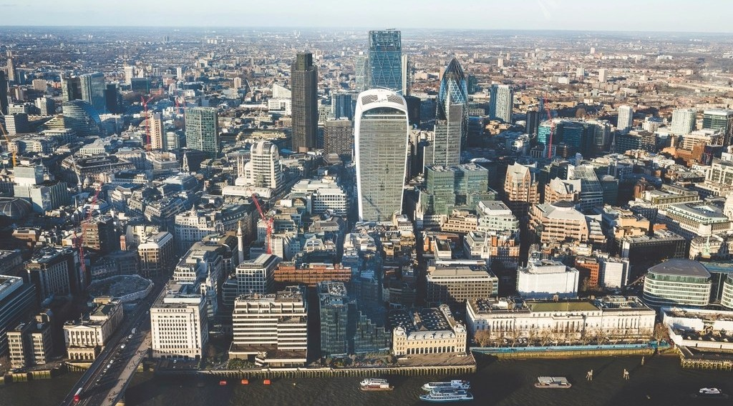
GEOGRAPHY — UPPER SIXTH ARTS
I. MEANING
Activity 1
A city in a rich country.
2026 / 2027
DGCAST GAROUA — GEOGRAPHY DEPARTMENT
Mr KAMDEM E. | 14
Notes:
Without the projector: give examples.

Slide 15
GEOGRAPHY — UPPER SIXTH ARTS
I. MEANING
Activity 1: Question
Distinguish economic growth and development.
2026 / 2027
DGCAST GAROUA — GEOGRAPHY DEPARTMENT
Mr KAMDEM E. | 15

Slide 16
GEOGRAPHY — UPPER SIXTH ARTS
I. MEANING
Answer
Growth is a rise in output; development is a better life for all people.
2026 / 2027
DGCAST GAROUA — GEOGRAPHY DEPARTMENT
Mr KAMDEM E. | 16

Slide 17
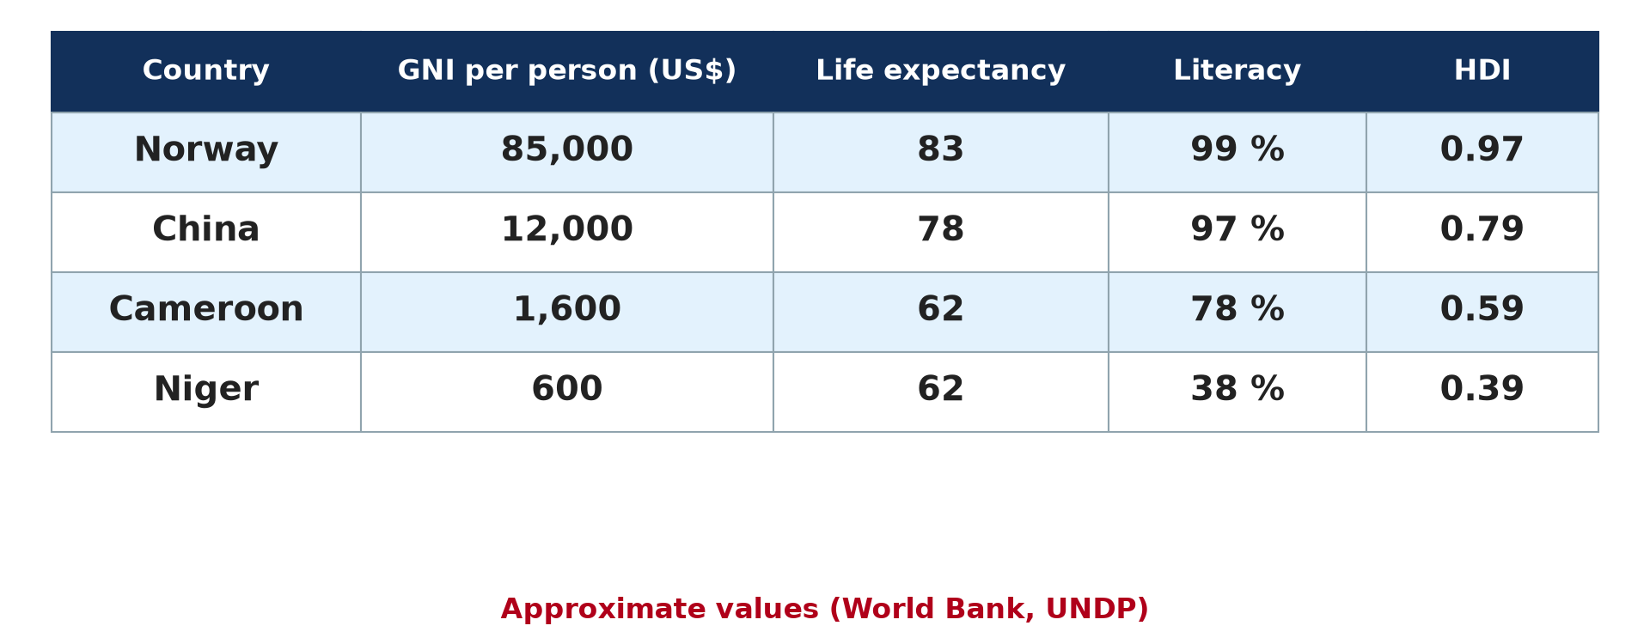
GEOGRAPHY — UPPER SIXTH ARTS
II. CRITERIA
Activity 2
Development indicators (approximate).
2026 / 2027
DGCAST GAROUA — GEOGRAPHY DEPARTMENT
Mr KAMDEM E. | 17
Notes:
Without the projector: read the table.

Slide 18
GEOGRAPHY — UPPER SIXTH ARTS
II. CRITERIA
Activity 2: Question
Name two economic and two social criteria of development.
2026 / 2027
DGCAST GAROUA — GEOGRAPHY DEPARTMENT
Mr KAMDEM E. | 18

Slide 19
GEOGRAPHY — UPPER SIXTH ARTS
II. CRITERIA
Answer
Economic: GNI per person, jobs. Social: life expectancy, literacy.
2026 / 2027
DGCAST GAROUA — GEOGRAPHY DEPARTMENT
Mr KAMDEM E. | 19

Slide 20
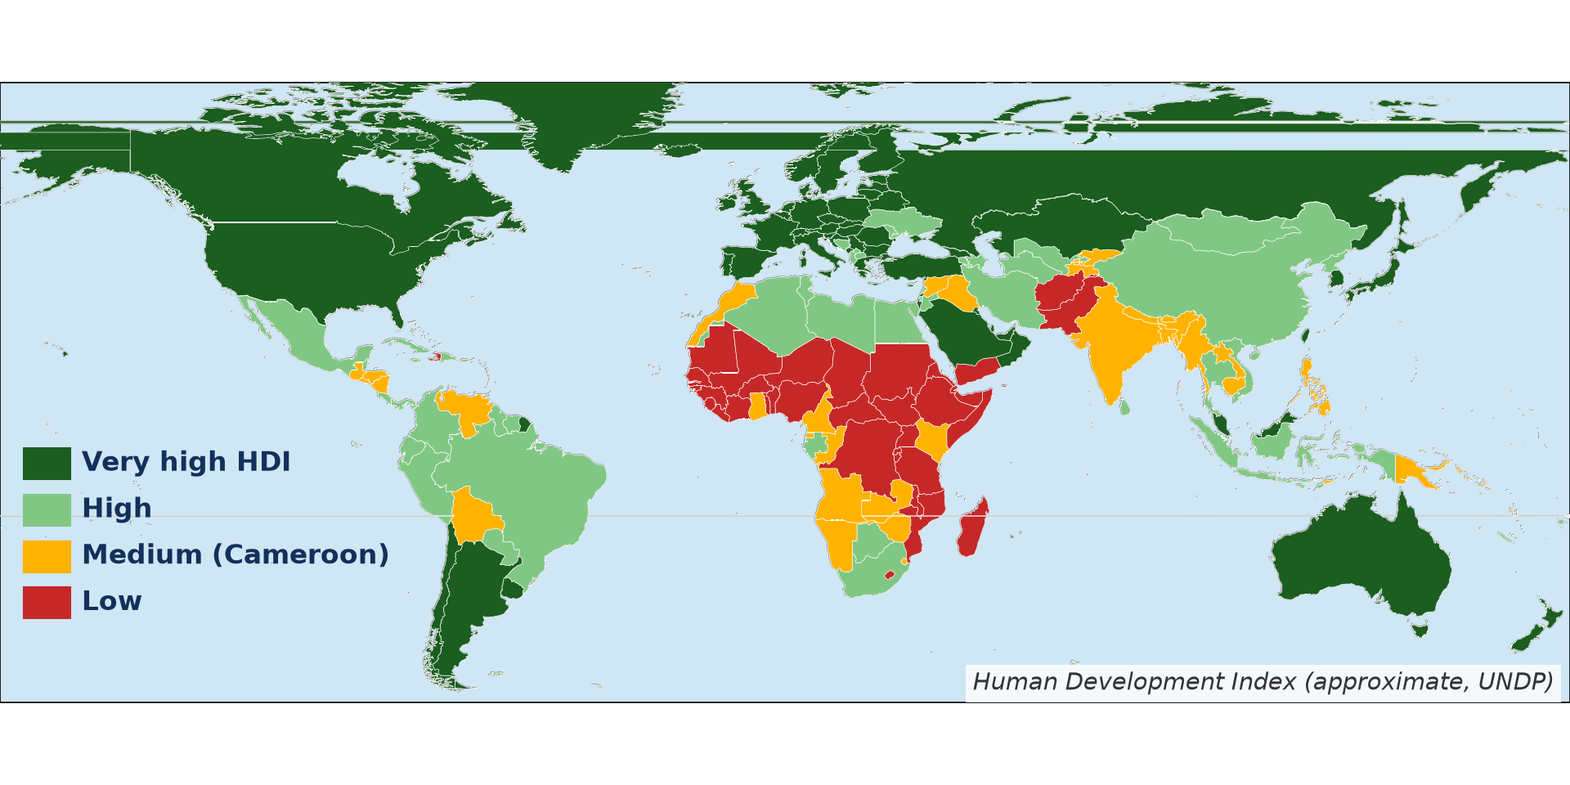
GEOGRAPHY — UPPER SIXTH ARTS
II. HDI
Activity 3
Human Development Index (approximate).
2026 / 2027
DGCAST GAROUA — GEOGRAPHY DEPARTMENT
Mr KAMDEM E. | 20
Notes:
Without the projector: read the map.

Slide 21
GEOGRAPHY — UPPER SIXTH ARTS
II. HDI
Activity 3: Question
Which region has most low-HDI countries?
2026 / 2027
DGCAST GAROUA — GEOGRAPHY DEPARTMENT
Mr KAMDEM E. | 21

Slide 22
GEOGRAPHY — UPPER SIXTH ARTS
II. HDI
Answer
Sub-Saharan Africa.
2026 / 2027
DGCAST GAROUA — GEOGRAPHY DEPARTMENT
Mr KAMDEM E. | 22

Slide 23

GEOGRAPHY — UPPER SIXTH ARTS
III. THE GAP
Activity 4
A poor neighbourhood.
2026 / 2027
DGCAST GAROUA — GEOGRAPHY DEPARTMENT
Mr KAMDEM E. | 23
Notes:
Without the projector: discuss reasons.

Slide 24
GEOGRAPHY — UPPER SIXTH ARTS
III. THE GAP
Activity 4: Question
Give three reasons for the gap between rich and poor countries.
2026 / 2027
DGCAST GAROUA — GEOGRAPHY DEPARTMENT
Mr KAMDEM E. | 24

Slide 25
GEOGRAPHY — UPPER SIXTH ARTS
III. THE GAP
Answer
Colonial history, unfair trade and debt (also poor governance, conflicts, climate).
2026 / 2027
DGCAST GAROUA — GEOGRAPHY DEPARTMENT
Mr KAMDEM E. | 25

Slide 26
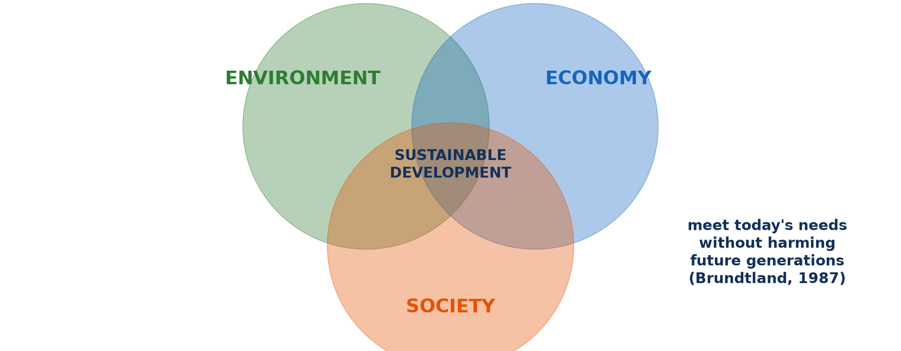
GEOGRAPHY — UPPER SIXTH ARTS
IV. SUSTAINABLE DEVELOPMENT
Activity 5
The three pillars.
2026 / 2027
DGCAST GAROUA — GEOGRAPHY DEPARTMENT
Mr KAMDEM E. | 26
Notes:
Without the projector: explain the circles.

Slide 27
GEOGRAPHY — UPPER SIXTH ARTS
IV. SUSTAINABLE DEVELOPMENT
Activity 5: Question
What is sustainable development?
2026 / 2027
DGCAST GAROUA — GEOGRAPHY DEPARTMENT
Mr KAMDEM E. | 27

Slide 28
GEOGRAPHY — UPPER SIXTH ARTS
IV. SUSTAINABLE DEVELOPMENT
Answer
Development that meets today's needs without harming future generations.
2026 / 2027
DGCAST GAROUA — GEOGRAPHY DEPARTMENT
Mr KAMDEM E. | 28

Slide 29
GEOGRAPHY — UPPER SIXTH ARTS
BOARD SUMMARY
Notion of Development
Topic: Current Development Issues
Sub-topic: Concept of Development
Lesson 7: Notion of Development
2026 / 2027
DGCAST GAROUA — GEOGRAPHY DEPARTMENT
Mr KAMDEM E. | 29
Notes:
Learners copy the board summary now. Give them enough time for each slide.

Slide 30
GEOGRAPHY — UPPER SIXTH ARTS
BOARD SUMMARY
I. Definitions
Development: It is the improvement of people's living standards and wellbeing.
Economic growth: It is the increase in the output of goods and services of a country.
HDI: It is an index from 0 to 1 that combines income, life expectancy and education.
2026 / 2027
DGCAST GAROUA — GEOGRAPHY DEPARTMENT
Mr KAMDEM E. | 30

Slide 31
GEOGRAPHY — UPPER SIXTH ARTS
BOARD SUMMARY
II. Measuring and Classifying (1/3)
A. Economic criteria: GNI per person, jobs in industry and energy use measure wealth. They hide inequality.
B. Social criteria: Life expectancy, literacy, doctors and clean water show welfare. The HDI combines several criteria.
2026 / 2027
DGCAST GAROUA — GEOGRAPHY DEPARTMENT
Mr KAMDEM E. | 31

Slide 32
GEOGRAPHY — UPPER SIXTH ARTS
BOARD SUMMARY
II. Measuring and Classifying (2/3)
C. Classification: Countries are classed as developed (MEDCs), developing (LEDCs) or least developed. Cameroon has a medium HDI.
2026 / 2027
DGCAST GAROUA — GEOGRAPHY DEPARTMENT
Mr KAMDEM E. | 32

Slide 33
GEOGRAPHY — UPPER SIXTH ARTS
BOARD SUMMARY
II. Measuring and Classifying (3/3)
Copy the table.
2026 / 2027
DGCAST GAROUA — GEOGRAPHY DEPARTMENT
Mr KAMDEM E. | 33

Slide 34
GEOGRAPHY — UPPER SIXTH ARTS
BOARD SUMMARY
III. The Gap and Sustainable Development
A. Reasons for the gap: Colonialism, unfair trade, debt, poor governance and conflicts keep countries poor. Harsh climates and diseases also slow development.
B. Sustainable development: It balances economy, society and environment. Clean energy, education and good governance help to achieve it.
2026 / 2027
DGCAST GAROUA — GEOGRAPHY DEPARTMENT
Mr KAMDEM E. | 34

Slide 35
GEOGRAPHY — UPPER SIXTH ARTS
FORMATIVE EVALUATION
Formative Evaluation 1
Distinguish development and growth.
2026 / 2027
DGCAST GAROUA — GEOGRAPHY DEPARTMENT
Mr KAMDEM E. | 35

Slide 36
GEOGRAPHY — UPPER SIXTH ARTS
FORMATIVE EVALUATION
Expected Answer
Growth is more output; development is a better life for people.
2026 / 2027
DGCAST GAROUA — GEOGRAPHY DEPARTMENT
Mr KAMDEM E. | 36

Slide 37
GEOGRAPHY — UPPER SIXTH ARTS
FORMATIVE EVALUATION
Formative Evaluation 2
Give three components of the HDI.
2026 / 2027
DGCAST GAROUA — GEOGRAPHY DEPARTMENT
Mr KAMDEM E. | 37

Slide 38
GEOGRAPHY — UPPER SIXTH ARTS
FORMATIVE EVALUATION
Expected Answer
Income, life expectancy and education.
2026 / 2027
DGCAST GAROUA — GEOGRAPHY DEPARTMENT
Mr KAMDEM E. | 38

Slide 39
GEOGRAPHY — UPPER SIXTH ARTS
REMEDIATION
Remediation
Fill in the blanks:
An index of income, health and education is the ______.
Cameroon has a ______ HDI.
Development that protects future generations is ______.
2026 / 2027
DGCAST GAROUA — GEOGRAPHY DEPARTMENT
Mr KAMDEM E. | 39
Notes:
Answers: 1. HDI 2. medium 3. sustainable

Slide 40
GEOGRAPHY — UPPER SIXTH ARTS
HOMEWORK
Homework
Compare Cameroon with one African country using three development indicators.
This prepares Lesson 8: Strategies of Development.
2026 / 2027
DGCAST GAROUA — GEOGRAPHY DEPARTMENT
Mr KAMDEM E. | 40
Notes:
This homework prepares the next lesson.

Slide 41
GEOGRAPHY — UPPER SIXTH ARTS
BILINGUAL GAME
Bilingual Game (Jeu Bilingue)
English | Français
Development | Le développement
Growth | La croissance
Income | Le revenu
Life expectancy | L'espérance de vie
Literacy | L'alphabétisation
Gap | L'écart
2026 / 2027
DGCAST GAROUA — GEOGRAPHY DEPARTMENT
Mr KAMDEM E. | 41
Notes:
Say the English word; learners give the French word, then the reverse.

Slide 42
GEOGRAPHY — UPPER SIXTH ARTS
LOGBOOK
Official Logbook (1/2)
Module / Topic | Current Development Issues
Lesson Title | Lesson 7: Notion of Development
Expected Learning Outcomes | Distinguish development and economic growth. Measure development with economic and social criteria. Explain the development gap and sustainable development.
Competence | Learners are able to measure development, explain the development gap and suggest ways to achieve sustainable development.
2026 / 2027
DGCAST GAROUA — GEOGRAPHY DEPARTMENT
Mr KAMDEM E. | 42

Slide 43
GEOGRAPHY — UPPER SIXTH ARTS
LOGBOOK
Official Logbook (2/2)
Matter Taught | I. Definitions: Development, Economic growth, HDI; II. Measuring and Classifying: Economic criteria, Social criteria, Classification; III. The Gap and Sustainable Development: Reasons for the gap, Sustainable development.
Evaluation | Formative evaluation (3 questions) and remediation exercise.
Homework | Compare Cameroon with one African country using three development indicators.
Enrolment / Present / Absent | ____ / ____ / ____
Achievement | To be completed by the teacher after the lesson.
2026 / 2027
DGCAST GAROUA — GEOGRAPHY DEPARTMENT
Mr KAMDEM E. | 43

Slide 44
GEOGRAPHY — UPPER SIXTH ARTS
TEACHER'S NOTE
Teacher's Note
Timing: Set-up, recall 8 min | Situation 8 min | 5 activities 30 min | Board summary (copying) 30 min | Evaluation, remediation 10 min | Homework, logbook 9 min | Spare 5 min
2026 / 2027
DGCAST GAROUA — GEOGRAPHY DEPARTMENT
Mr KAMDEM E. | 44

Slide 45
GEOGRAPHY — UPPER SIXTH ARTS
REFERENCES
References
National Geography Syllabus, Sixth Forms (Lower & Upper Sixth), MINESEC/IGE/IP-SS, August 2019 — Module 7 (Environment and Development).
Photo, Activity 1: “Aerial View City Skyline Skyscraper” by unknown, CC0 1.0, via rawpixel (https://www.rawpixel.com/image/5967710/aerial-view-city-skyline-skyscraper)
Photo, Activity 4: “Mathare” by Book Aid International, CC BY-NC-ND 2.0, via Flickr (https://www.flickr.com/photos/45024905@N07/4135561707)
Diagrams and animations: drawn for this lesson (DGCAST Geography Department).
2026 / 2027
DGCAST GAROUA — GEOGRAPHY DEPARTMENT
Mr KAMDEM E. | 45

